Slide 1

EMPOWERING WOMEN THROUGH FINANCIAL LITERACY
"Empowered women don’t just break barriers — they build financial legacies."
— Inspired by Melinda Gates

Slide 2


PROBLEM STATEMENT & CONTEXT
Problem Statement
Women face barriers in understanding and managing finances.
Lack of literacy leads to dependency, fraud vulnerability, and missed opportunities.
Context & Impact
Globally, women are 27% less likely to access formal financial services.
In India, only 33% of women are financially literate (vs. 55% of men).
Limits participation in investments and wealth-building.

Slide 3
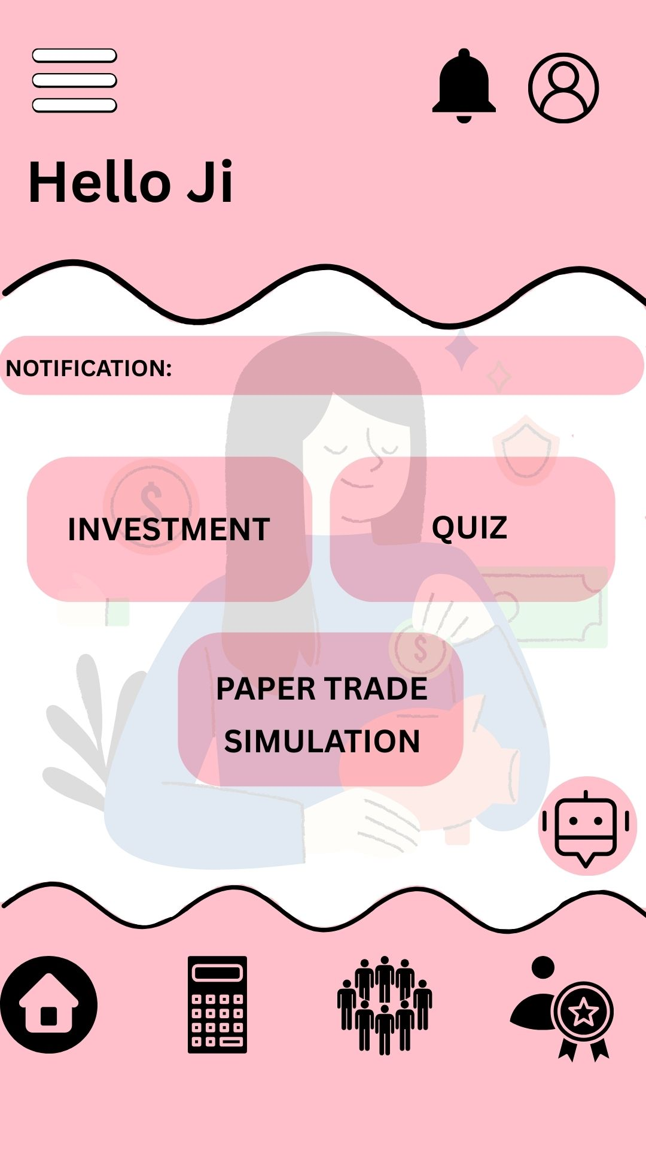
FIN-POWER-HER
Mission
Empower women through financial education, technology, and community.
Promote independence and informed decision-making.
Overview
Tech-based learning with multilingual support.
Personalized strategies, AI-driven insights, and real-life simulations.
Fosters long-term planning and confident financial behavior.

Slide 4

PLATFORM VISION & UNIQUE VALUE PROPOSITION
Vision
Build a platform that merges education, simulation, and expert support.
Enable secure, confident, and goal-oriented financial decisions.
Value Proposition
Simplifies complex topics into personalized, actionable steps.
Live chatbot, real-time dashboards, and expert webinars.
Designed for trust, accessibility, and clarity.

Slide 5
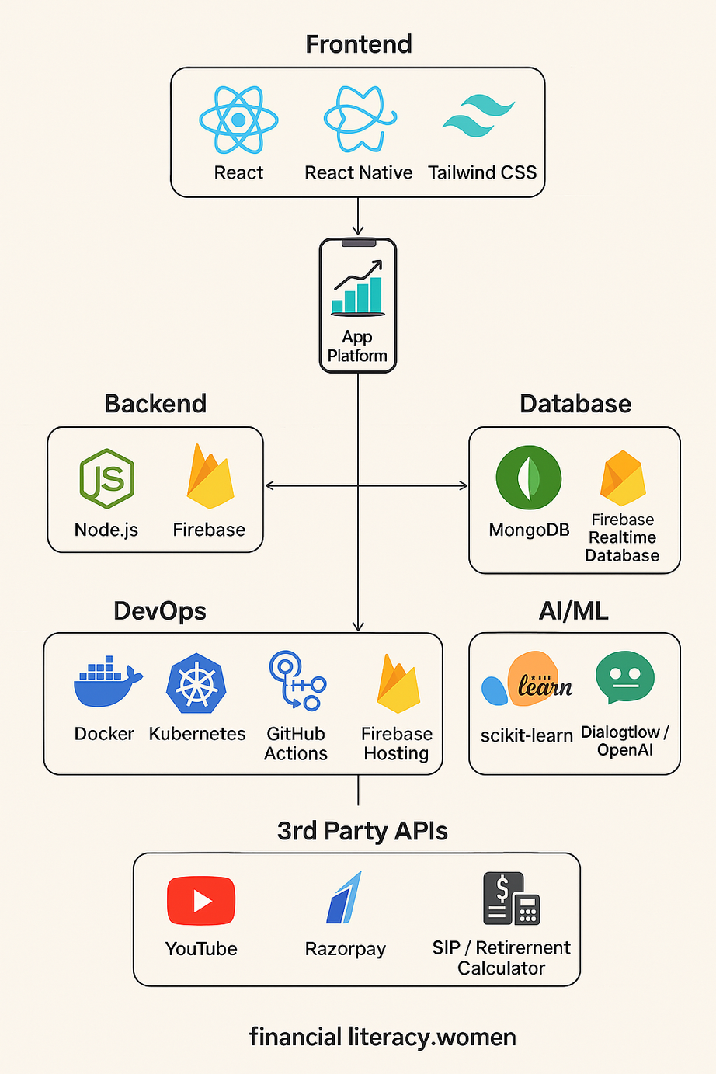

Slide 6
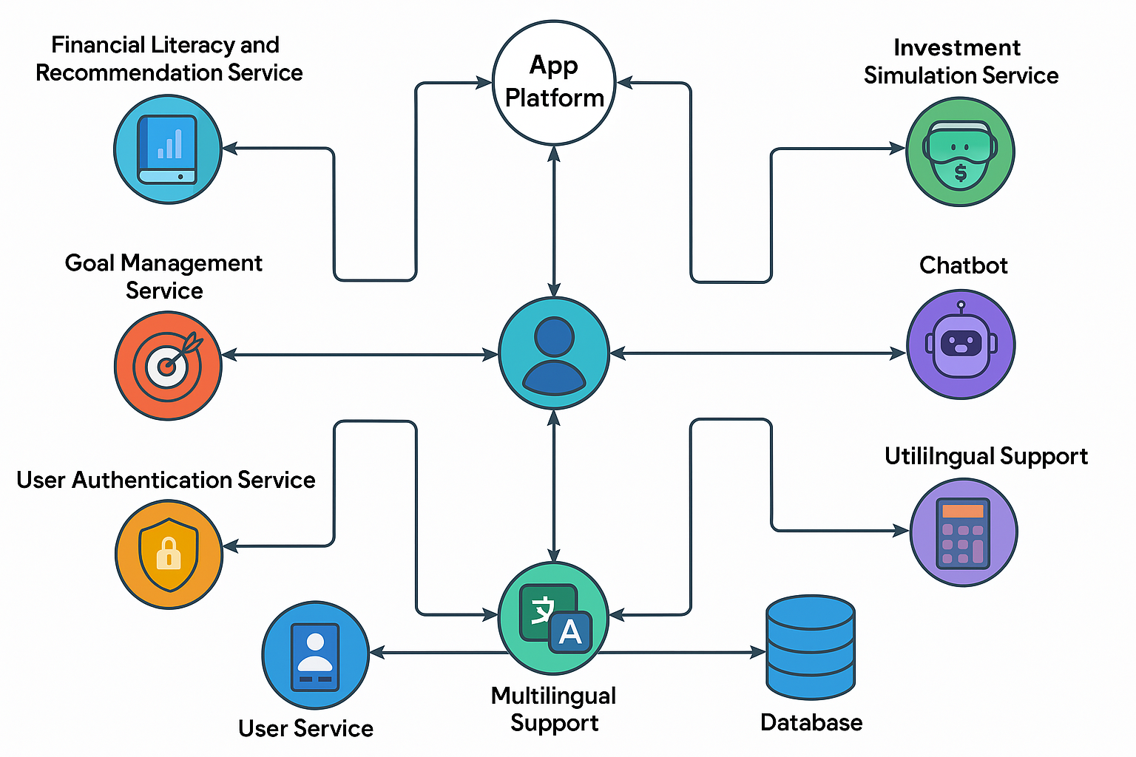

Slide 7
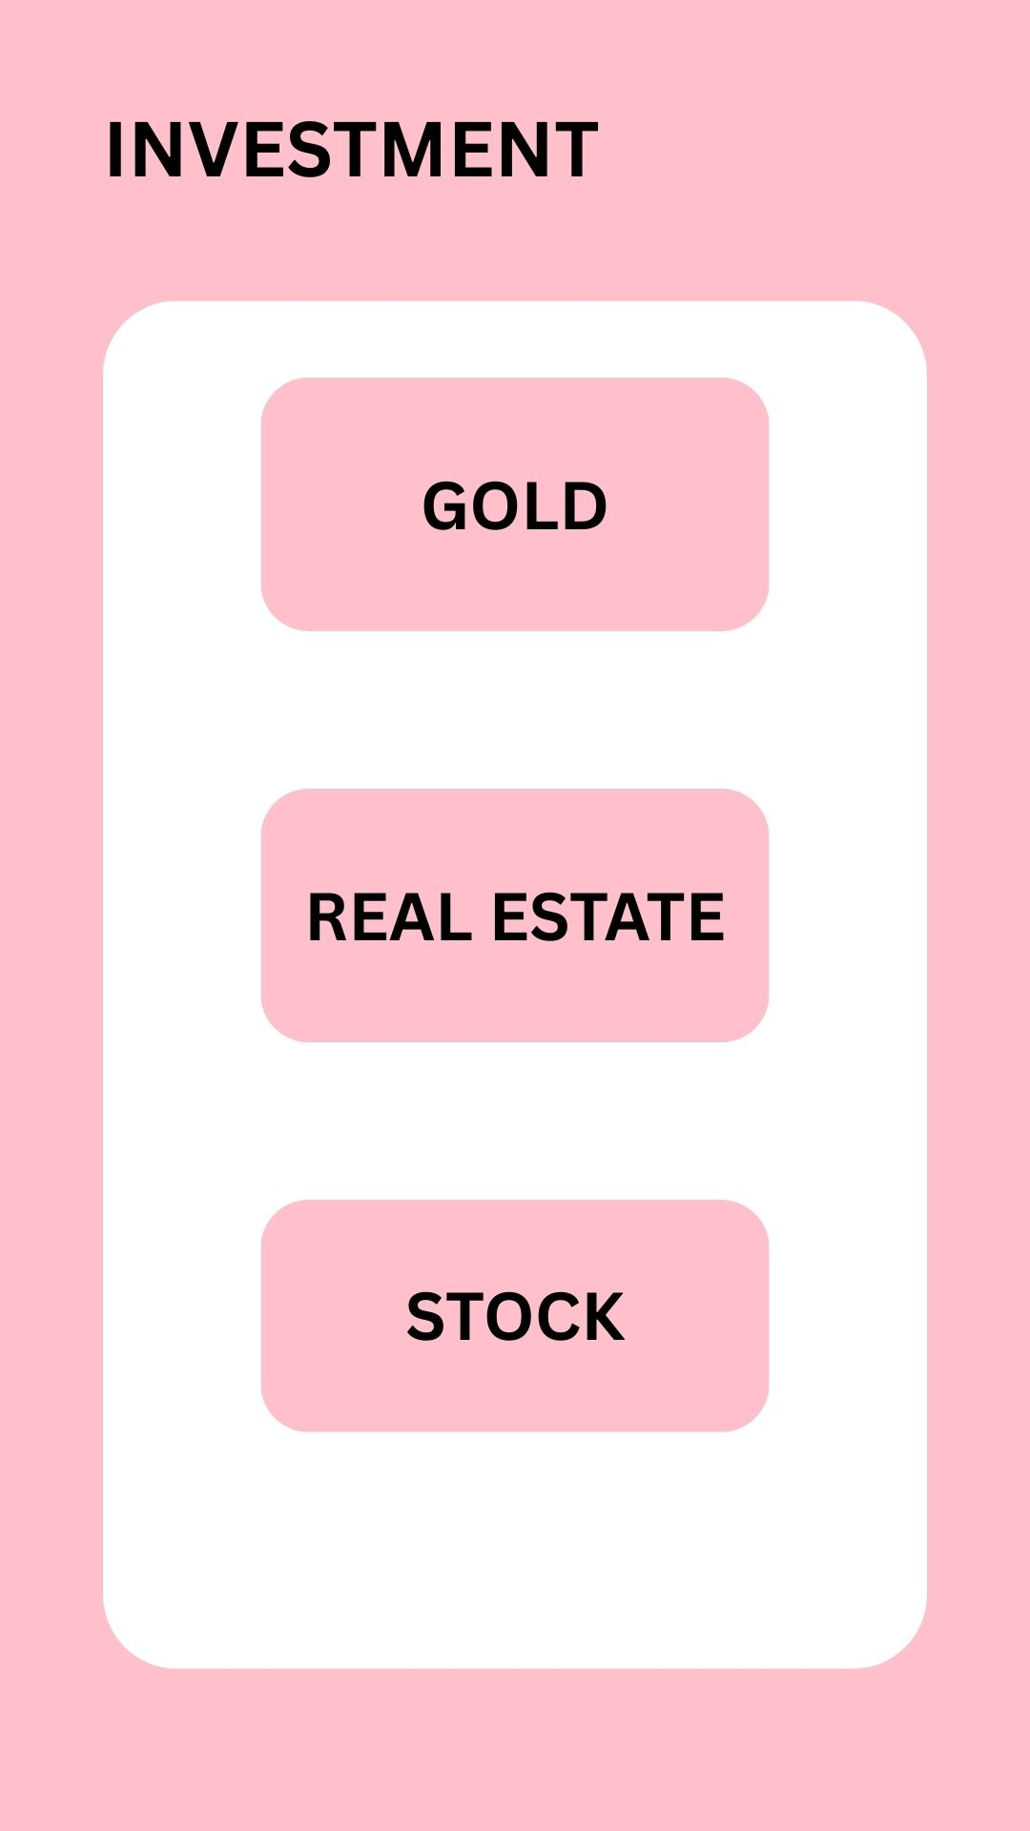
ONBOARDING – TAILORED FINANCIAL GOAL SELECTION
Personalized Entry Point
Users choose their goals right at the start:
Save taxes
Save money
Learn investing
Plan child’s education
Plan for retirement
Smart Journey Mapping
Goals align the app’s content, dashboard, and recommendations.

Slide 8


HOME DASHBOARD – INVEST &
MANIFEST OPTIONS
Dual Dashboard View
Invest: Real-time options and tools to grow wealth.
Manifest: Practice and simulate financial choices before real investment.
User-Centric Design
Encourages both immediate action and habit-building.

Slide 9

FIRST TWO ACTION STEPS – QUIZ & EXPERT CONSULTATION
Step 1: Finance Security Quiz
Interactive quiz to assess user’s financial awareness.
Tailors the next steps and investment suggestions.
Step 2: Talk to an Expert
In-app expert guidance for personalized advice.
Builds trust and early clarity.

Slide 10
INVEST SECTION – DIVERSE INVESTMENT OPTIONS
Investment Options Available:
🪙 Gold & Silver: Traditional and secure
📈 Stocks: Long-term capital growth
🏠 Real Estate: Tangible asset investment
🎓 Child Education & 🏥 Health Insurance
🆘 Emergency Fund & 💸 Tax Saving Plans
Dashboard View
Each investment has a summary, risk profile, and
potential return info.

Slide 11
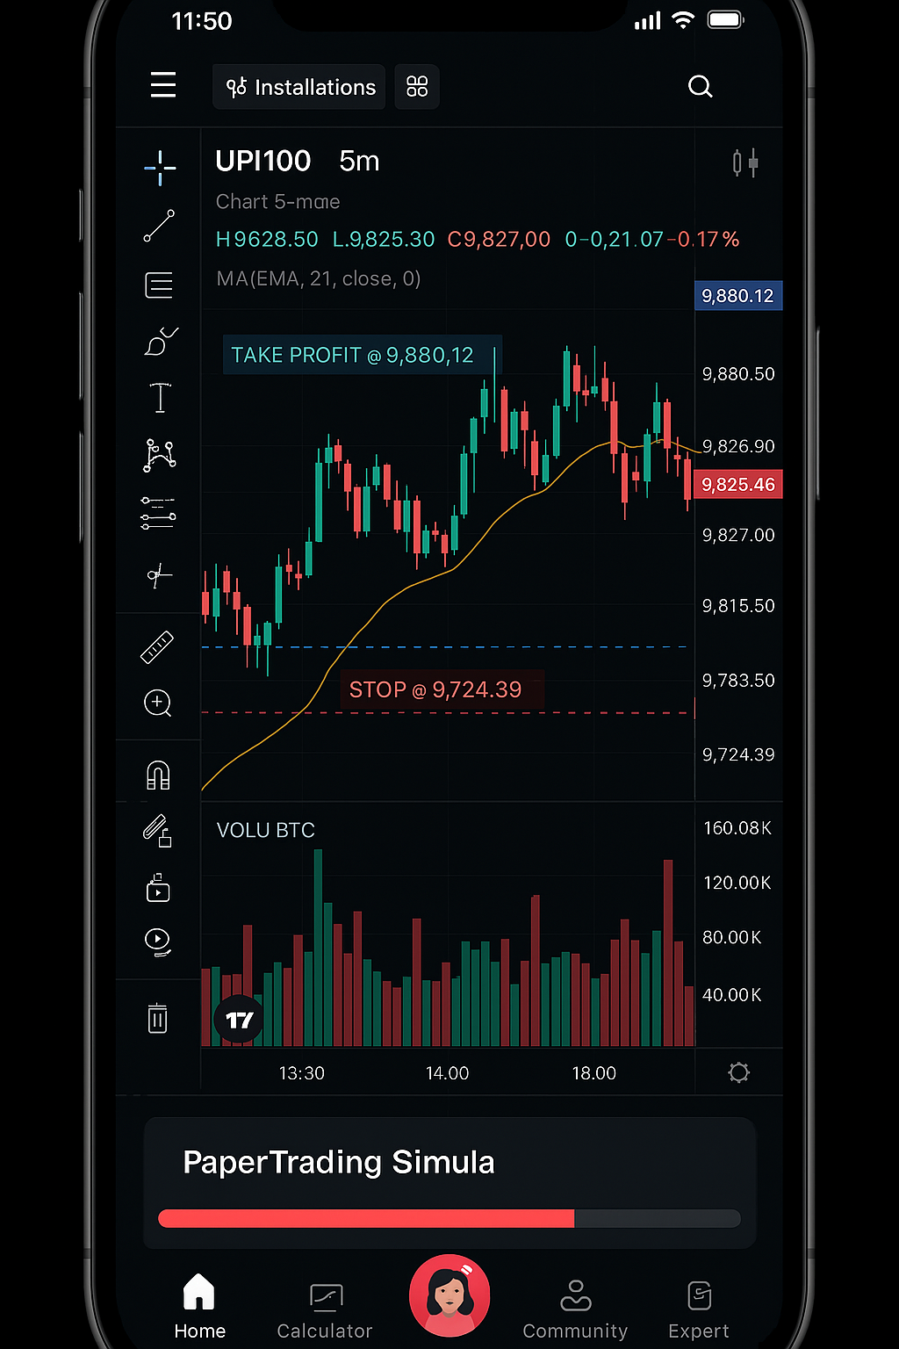
MANIFEST SECTION – FINANCIAL SIMULATION WITH PAPER MONEY
Paper Money Simulation
Allocate paper money based on income level.
Build habits in a safe, no-risk environment.
Monthly Expense Tracker
Track and reflect on spending patterns with simulated
currency.
Reinforce budgeting and financial discipline.

Slide 12

MANIFEST – INVESTMENT MODES &
CHATBOT ASSISTANCE
Two Modes of Investing:
Custom Mode: Manual investments using
real-time insights.
Auto Mode: AI chatbot invests automatically
(80% profit – 20% margin risk).
Smart Chatbot Assistant:
24/7 FAQ support with links to YouTube tutorials and
finance guides.
Solves queries related to investments, delays,
and app use.

Slide 13
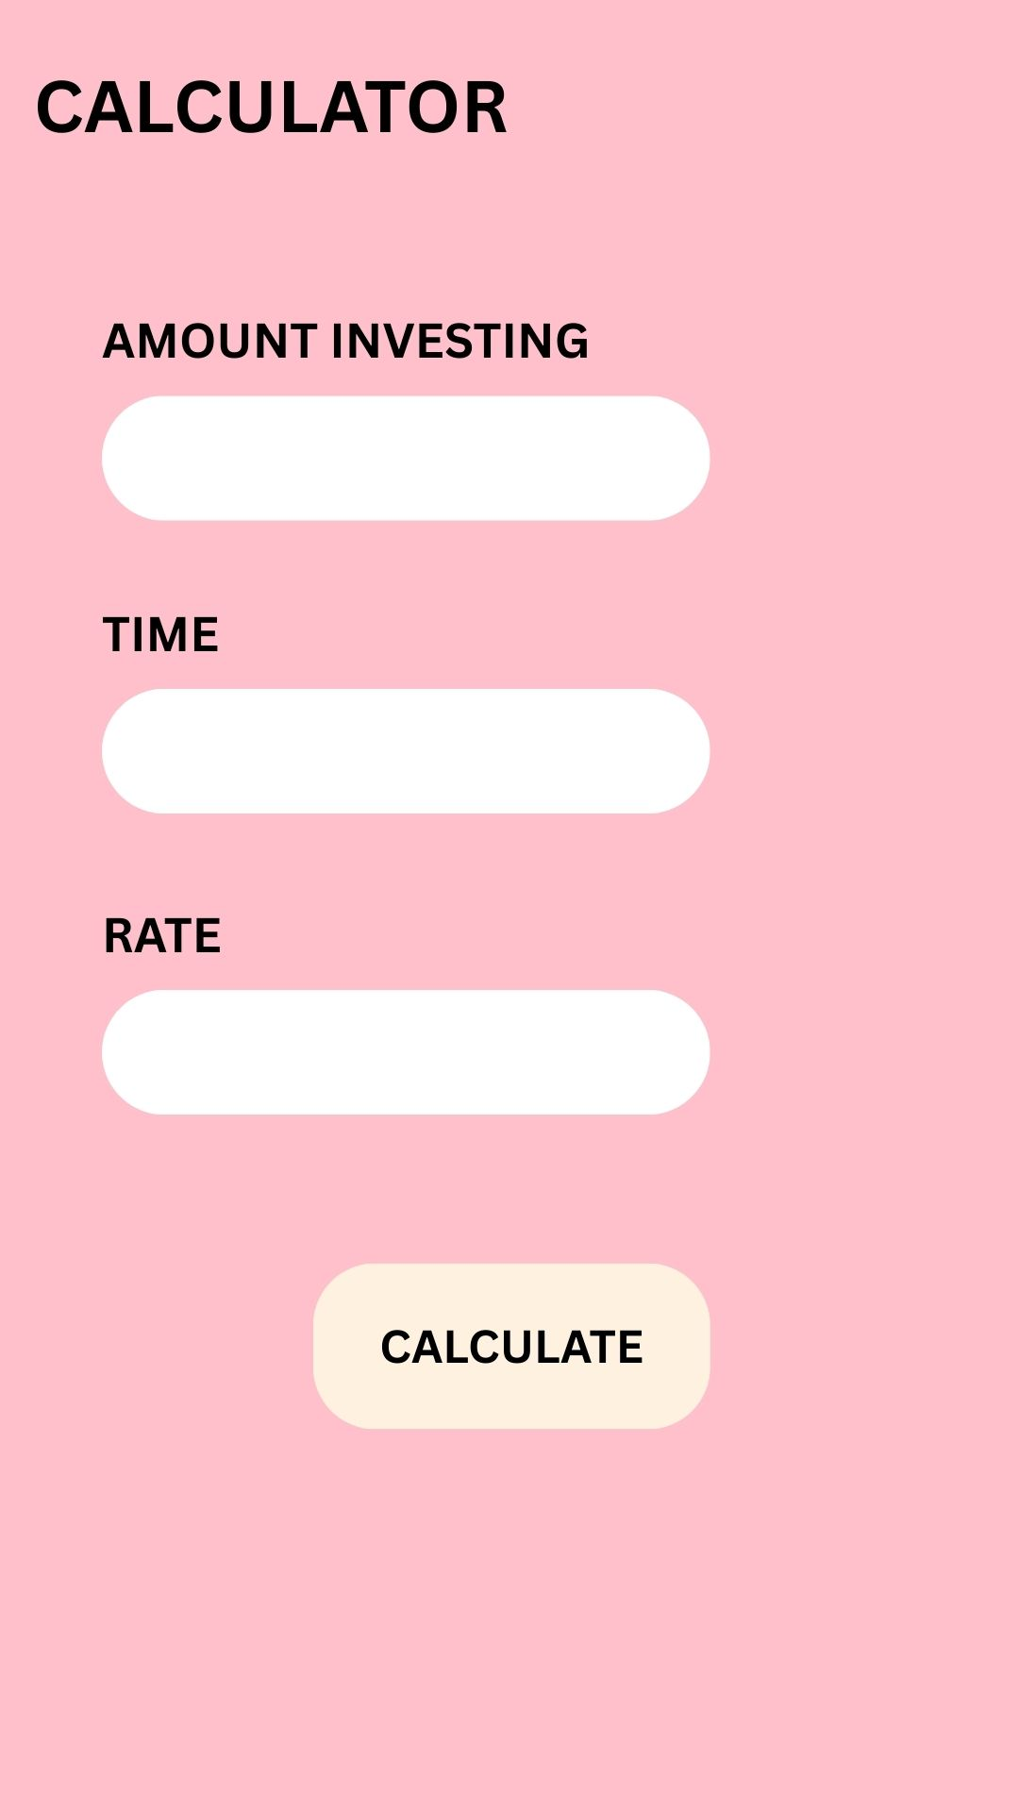
ADDITIONAL FEATURES &
EXPERT GUIDANCE
Extra Tools:
SIP Calculator
Retirement Planning Toolkit
Multilingual Support
Daily Expense Tracker
Expert Webinars:
Curated sessions by top financial literacy experts.
Available through dedicated webinar library.

Slide 14
THANK YOU

